Slide 1


Intermediate Python
Automation

Slide 2
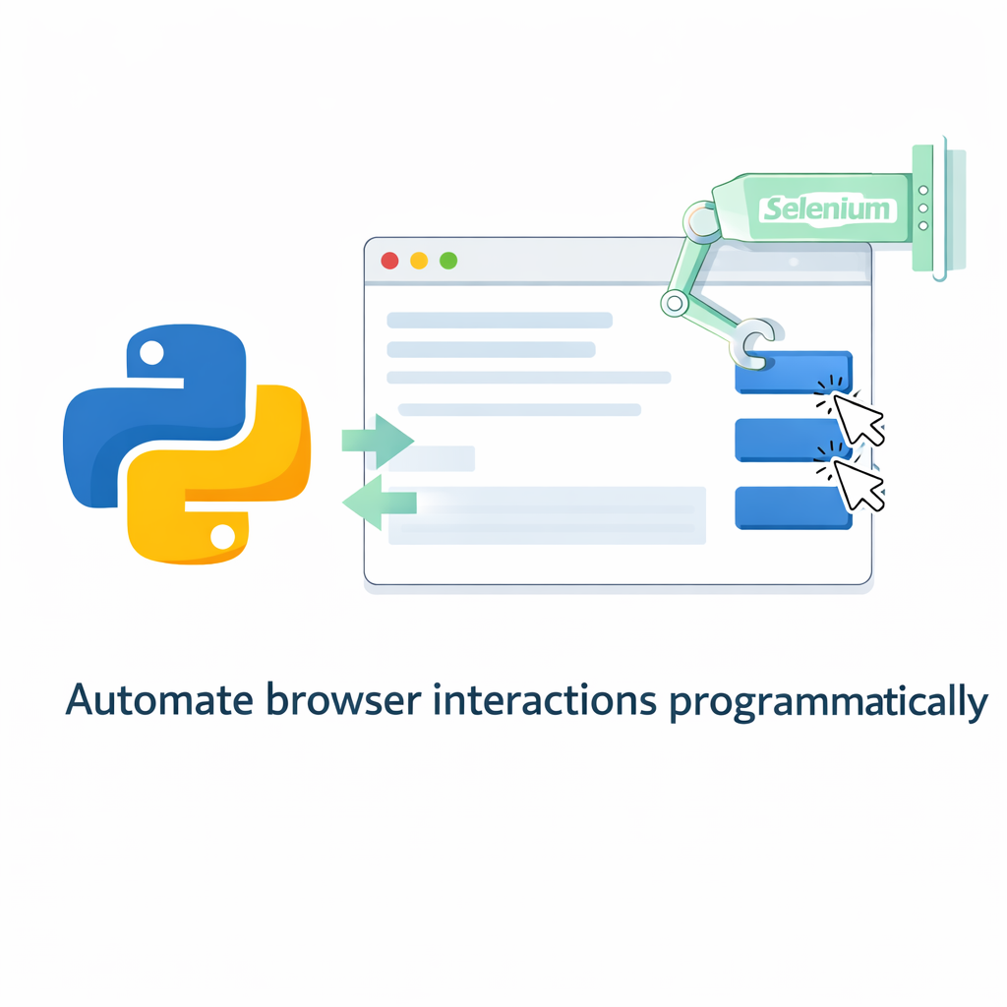
Web Automation with Selenium
Automate browser actions to simulate real user behavior.
Control browsers programmatically (Chrome, Firefox)
Automate login, form submission, navigation
Extract web data (basic scraping)
Useful for testing & repetitive workflows
Requires WebDriver
Works with headless mode for automation servers
Notes:
Explain:
Selenium simulates real user interaction
Used heavily in test automation
Can automate login workflows and data extraction
Important to discuss ethical use

Slide 3
Code Example
from selenium import webdriver
from selenium.webdriver.common.by import By
driver = webdriver.Chrome()
driver.get("https://example.com")
title = driver.title
print("Page Title:", title)
driver.quit()

Slide 4
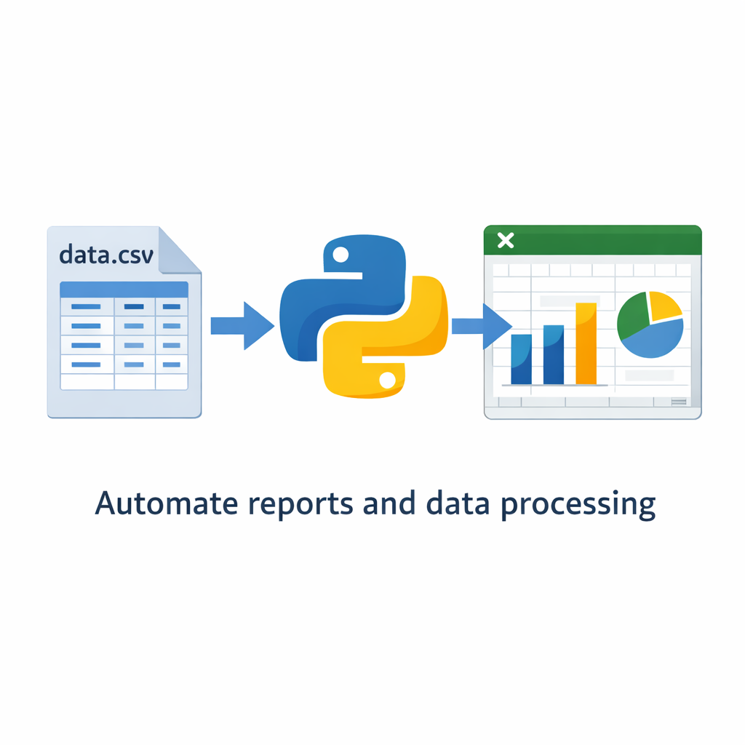
File & Excel Automation
Automate file processing and Excel manipulation using Python.
Read/write files automatically
Process large CSV datasets
Automate Excel reporting
Generate summaries & formatted reports
Use pandas & openpyxl
Replace manual spreadsheet tasks
Notes:
Explain:
Ideal for finance/admin automation
Reduces human error
Great use case for batch processing

Slide 5
Code Example
import pandas as pd
df = pd.read_csv("sales.csv")
summary = df.groupby("region")["amount"].sum()
summary.to_excel("report.xlsx")

Slide 6
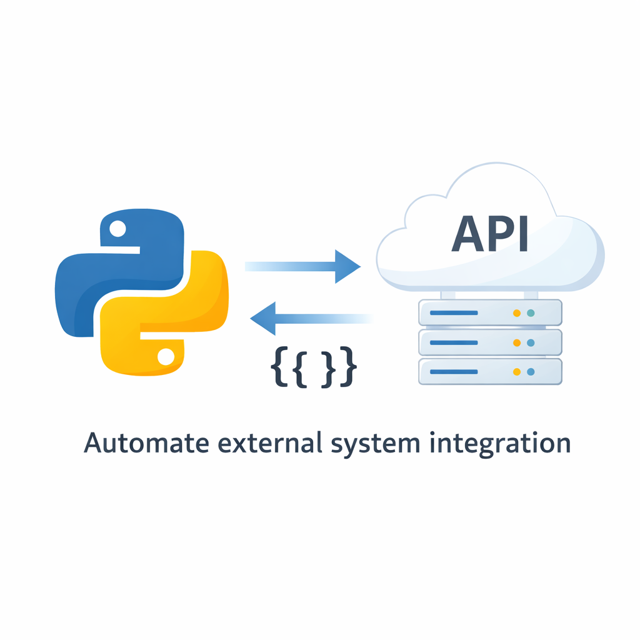
API Automation
Interact with external services automatically using APIs.
Send HTTP requests (GET, POST)
Integrate with external systems
Automate data retrieval
Parse JSON responses
Build automation pipelines
Foundation of backend integration
Notes:
Explain:
APIs allow system-to-system communication
Common in fintech, SaaS, automation workflows
JSON is the standard data format

Slide 7
Code Example
import requests
response = requests.get("https://api.github.com")
data = response.json()
print("API Status:", response.status_code)

Slide 8
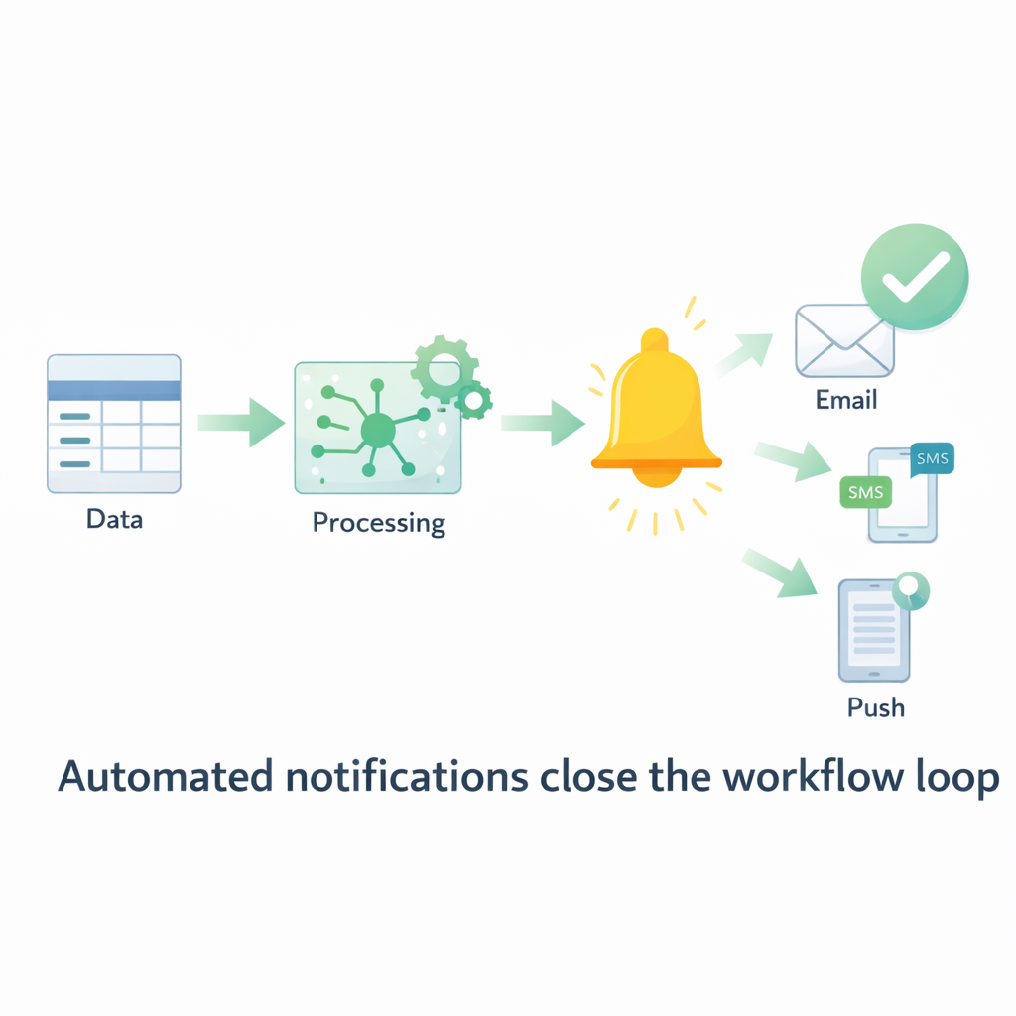
Notifications & Automation Workflows
Trigger automated notifications after tasks complete.
Send email alerts automatically
Integrate SMS or messaging services
Trigger notifications after data processing
Combine with API automation
Supports monitoring systems
Improves workflow transparency
Notes:
Explain:
Automation is incomplete without feedback
Notifications make systems observable
Used in monitoring, DevOps, finance reporting

Slide 9
Code Example
import smtplib
print("Sending email notification... (demo)")
(You can expand later with real SMTP setup)

